Slide 1
The consequences of economic insecurity
Conchita D’Ambrosio
conchita.dambrosio@uni.lu

Slide 2
With the WAP conference: we would like to take stock of recent evidence on individual and collective behavior in the light of repeated shocks (…) as well as on consequences and implications for (…).

Slide 3
With the WAP conference: we would like to take stock of recent evidence on individual and collective behavior in the light of repeated shocks (…) as well as on consequences and implications for (…).
Let us talk about economic insecurity.
Economic insecurity has emerged as a major research topic in a number of social science disciplines and appears more and more frequently in policy debates.

Slide 4
Household optimism scores with respect to their financial situation, savings, the threat of future unemployment, and the economic outlook in general have all dropped sharply over the recent decades.
Pessimism and its negative consequences on wellbeing have been fuelled by successive shocks such as the Great Recession, the refugee crisis, the Covid-19 Pandemic, the conflict in Ukraine.
There is a common perception among all social groups that economic instability is greatly affecting people’s lives.
Individuals feel economically insecure, a sentiment that is exacerbated by the de-standardization of the life course.

Slide 5
Economic insecurity is a multifaceted concept.
Stiglitz et al. (2009) refer to economic insecurity (henceforth EI) as stresses arising from “uncertainty about the material conditions that may prevail in the future”; for Osberg (1998) EI is “the anxiety produced by the lack of economic safety”;
Bossert and D’Ambrosio (2013) define EI as “the anxiety produced by the possible exposure to adverse economic events, and by the anticipation of the difficulty to recover from them”; for Jacobs (2016) “Economic insecurity is perhaps best understood as the intersection between “perceived” and “actual” downside risk.”

Slide 6
If we want to look at the consequences of EI, we will estimate of one of the most famous lines in all of Economics: reg y x
But what can we do if x hasn’t happened yet (and individual worry about it today)?
This is the case for economic insecurity

Slide 7
We can try to predict what might happen tomorrow from what has already happened in the past:
(i) Hacker et al. (2010). A drop in disposable family income of at least 25% and an inadequate financial safety net;
(ii) Bossert and D’Ambrosio (2013) and Bossert, Clark, D’Ambrosio and Lepinteur (2023). Past experiences of recovering from wealth/income shocks;
(iii) Rohde et al. (2014). The volatility arising from incomes dropping below the household's overall trend.

Slide 8
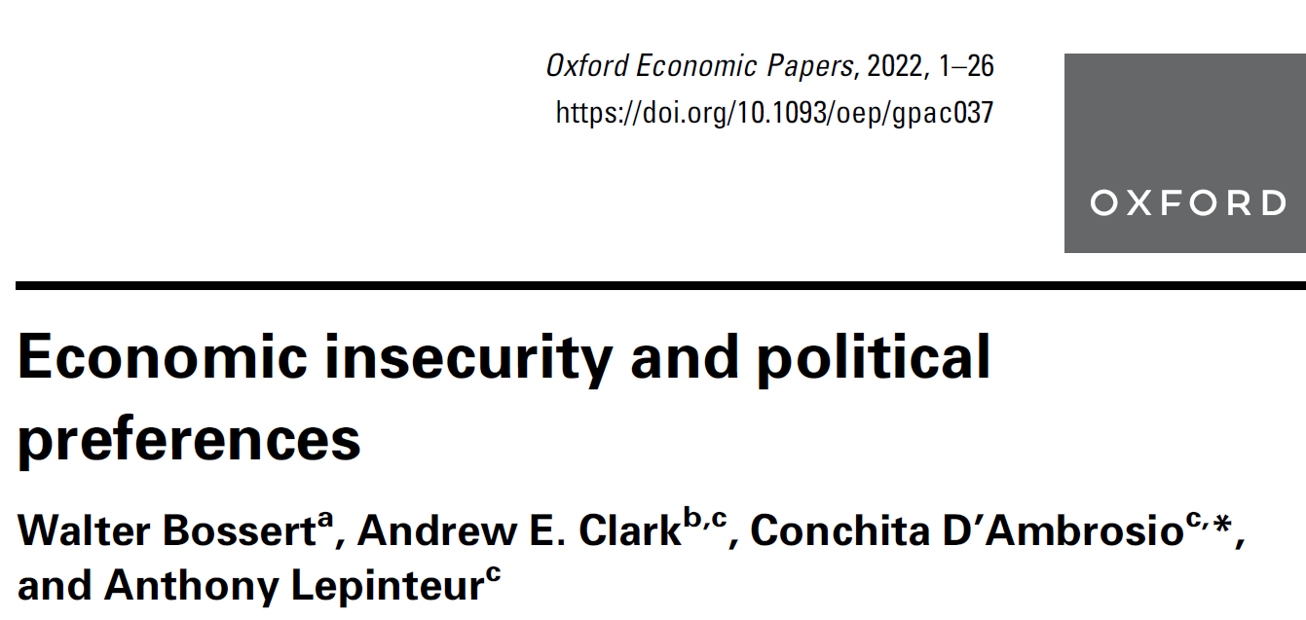
In Bossert, Clark, D’Ambrosio and Lepinteur (2023) we propose and axiomatically characterize a measure of IS.
We show that the insecure individuals vote Right-Wing and support Brexit.

Slide 9
A number of recent contributions have considered the link between economic insecurity and:
* support for populist parties (Guiso et al., 2020; Guriev and Papaioannou, 2022, among others)
* a lack of trust toward the EU (Algan et al., 2017; Dustmann et al., 2017; Foster and Frieden, 2017),
* the 2016 US Presidential election (Inglehart and Norris, 2016; Mutz, 2018, among many others),
* the 2016 UK referendum on EU membership (e.g., Sampson, 2017; Colantone and Stanig, 2018).

Slide 10
In the papers above, EI has been measured in a number of arguably ad hoc ways;
Algan et al. (2017) and Foster and Frieden (2017) measure insecurity as the change in the unemployment rate;
Inglehart and Norris (2016) by the Goldthorpe class measure, the experience of unemployment, living on benefits, urbanization, and self-reported difficulty in living on the current household income;
Dustmann et al. (2017) as per capita income and the unemployment rate;
Foster and Frieden (2017) by current unemployment;
Guiso et al. (2020) as the first principal component of the experience of unemployment over the past five years, self-reported difficulty in living on the current household income, and exposure to globalization (approximated by the type of employment, industry, and the worker’s skill level);
Mutz (2018) as the change in family income between 2012 and 2016, looking for work, and the subjective perception of family finances.

Slide 11
The individual economic-insecurity indices that we suggest measure the confidence with which individuals can face any potential future economic changes.
This confidence is argued to depend on their past experiences of gains and losses in resources.
The principle here is an old one.
For instance, Knight (1921, p. 199) states that, ‘all reasoning rests on the principle of analogy. We know the absent from the present, the future from the now, by assuming that connections or associations among phenomena which have been valid will be so; we judge the future by the past.’

Slide 12
Measuring Economic Insecurity
The index satisfies two key properties:
A gain (a loss) in income from one period to the next is associated with a lower (higher) level of insecurity, as compared to a situation in which no such change occurs.
Gain-Loss monotonicity.

Slide 13
Measuring Economic Insecurity
The index satisfies two key properties:
A gain (a loss) in income from one period to the next is associated with a lower (higher level) of insecurity, as compared to a situation in which no such change occurs.
The closer to today this change the larger the effect.
Proximity monotonicity.

Slide 14
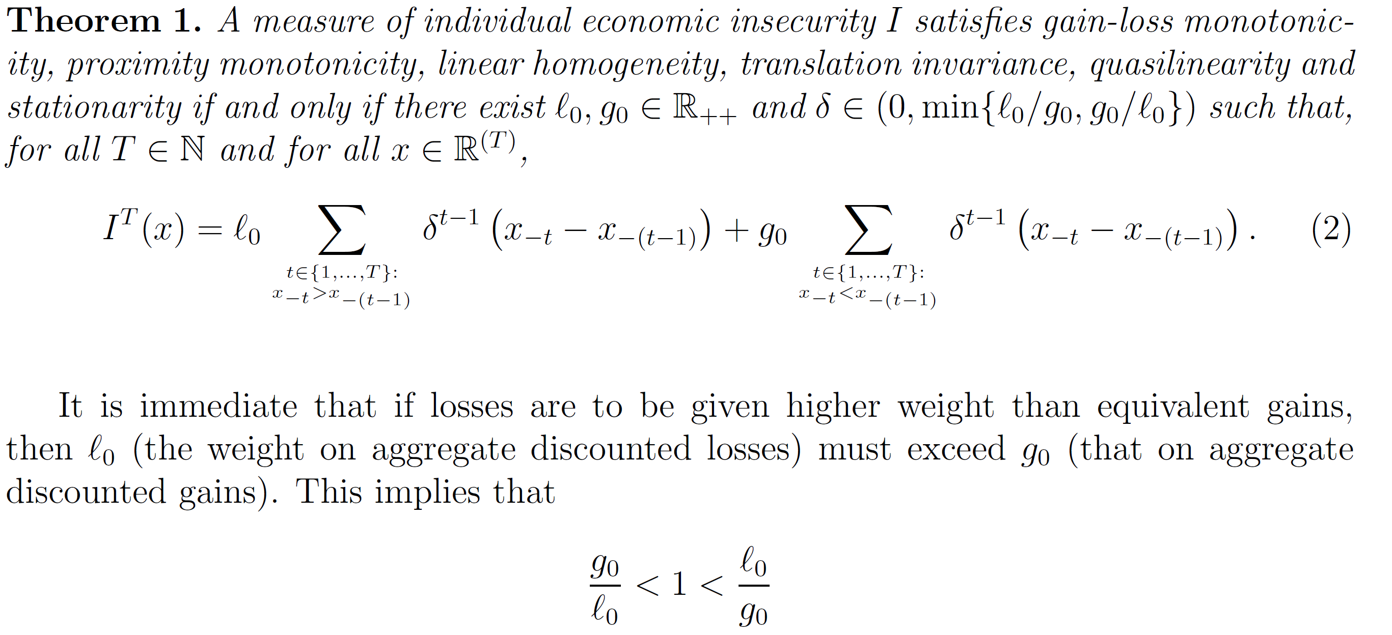
Measuring Economic Insecurity

Slide 15
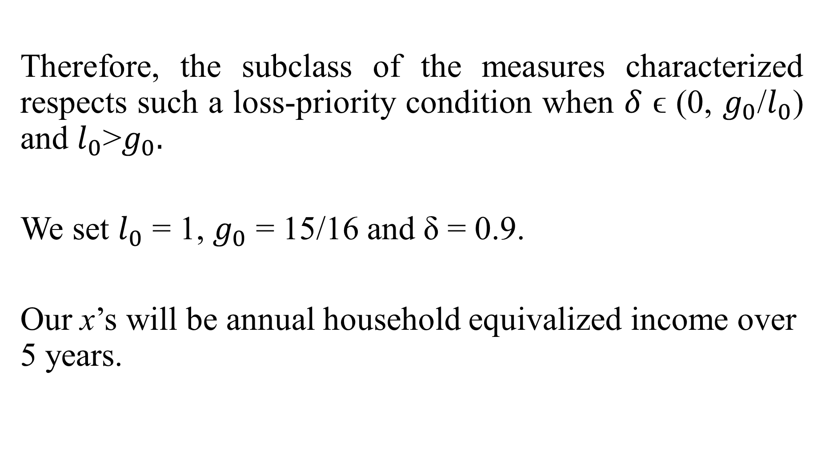
Therefore, the subclass of the measures characterized respects such a loss-priority condition when $δ$ ϵ (0, $g_{0}$/$l_{0}$) and $l_{0}$>$g_{0}.$
We set $l_{0}$ = 1, $g_{0}$ = 15/16 and δ = 0.9.
Our x’s will be annual household equivalized income over 5 years.

Slide 16
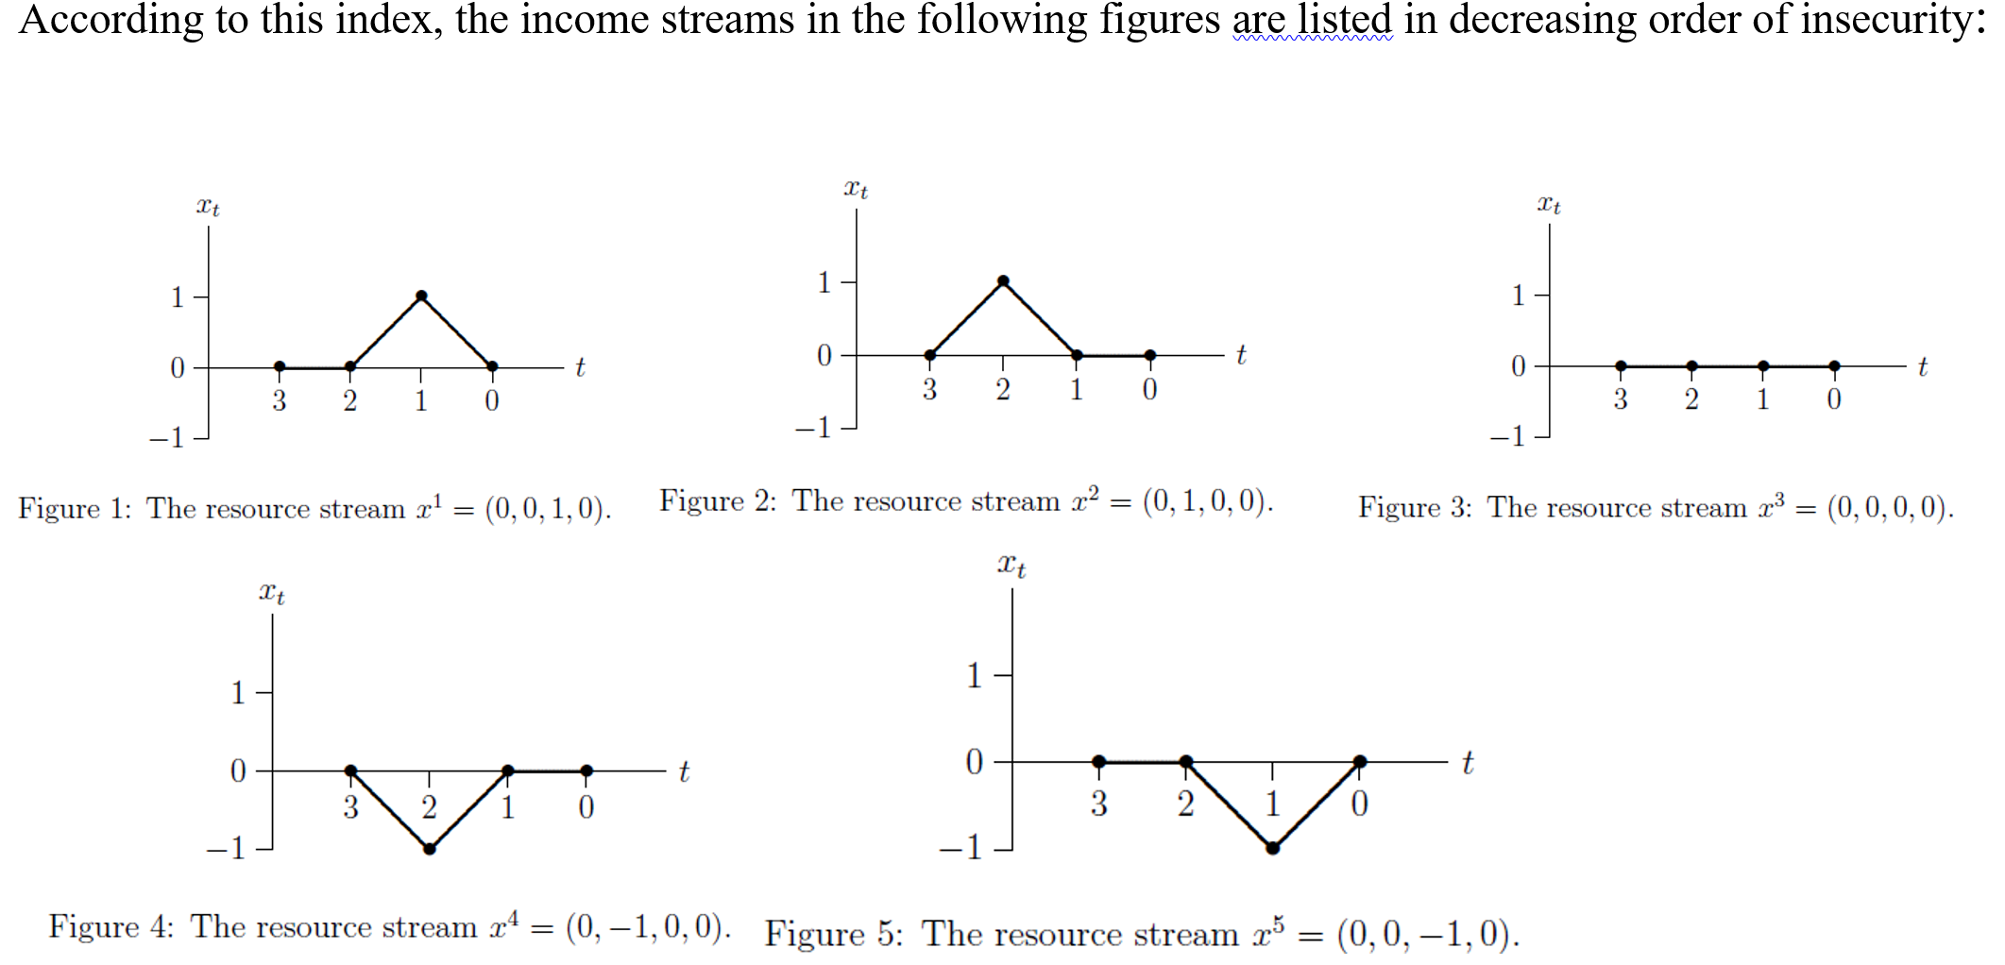
The least-insecure stream of income is permanently-rising; the most-insecure stream of income is permanently-falling. Any constant stream of income produces an insecurity score of zero.

Slide 17
Panel Data
We use data from the SOEP, BHPS/US and UAS.
UK. BHPS (1991-2008, and results on US) respondents are asked “Now I have a few questions about your views on politics. Generally speaking do you think of yourself as a supporter of any one political party?”, and “Do you think of yourself as a little closer to one political party than to the others?”. Those who reply “Yes” to either of these two questions mention which party they support.

Slide 18
If respondents say “No” to both questions, the interviewer asked: “If there were to be a General Election tomorrow, which political party do you think you would be most likely to support?”.
Individuals are considered as having no political preferences if they reply “No” to the first two questions and “None” or “Don’t know” to the hypothetical election question.
We create a categorical political-preference variable with the following categories: “Conservative Party”, “Liberal Party/SDP”, “Labour Party”, “Other Parties” and “No Political Preferences”.

Slide 19
Germany. SOEP (1985-2018)
Respondents are asked “Many people in Germany lean towards one party in the long term, even if they occasionally vote for another party. Do you lean towards a particular party?”.
If respondents answered “Yes”, they were then asked: “Toward which party do you lean?”.
Our political-preference variable in Germany has the following categories: “CDU/CSU”, “FPD”, “SPD”, “Other Parties” and “No Political Preferences”.

Slide 20
Our estimation samples cover individuals aged 18-65 who are not retired and with valid information on economic insecurity, household equivalized income and political preferences.
This produces 67,844 observations in the BHPS and 230,934 in the SOEP

Slide 21
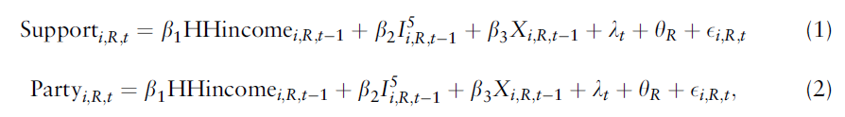
Regression Analysis
We estimate regressions for political preference of this type:
The vector X includes home-ownership (a wealth proxy). Both economic insecurity and equivalized household income are standardized so that the estimated coeff refer to the effect of a one-std change in these vars.
We use lagged values of HHinc and I to attenuate endogeneity concerns.

Slide 22
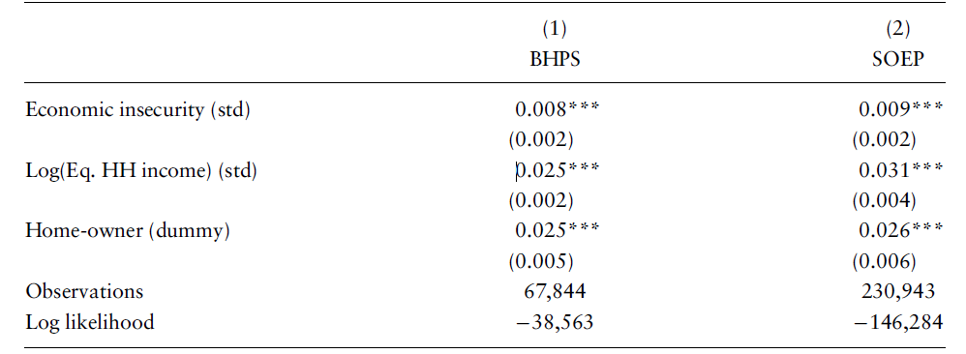
Probability of Supporting a Party: logit
A one standard-deviation rise in economic insecurity at t increases the probability of supporting any party at t+1 by about 1% points in both the UK and Germany.

Slide 23
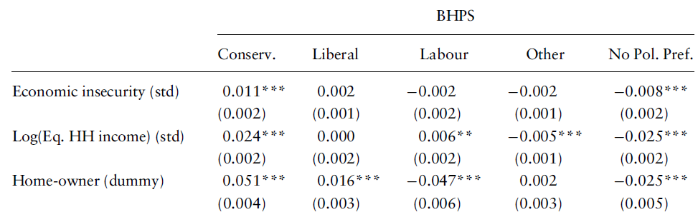
Economic insecurity mainly benefits Right-wing parties: BHPS multinomial logit

Slide 24
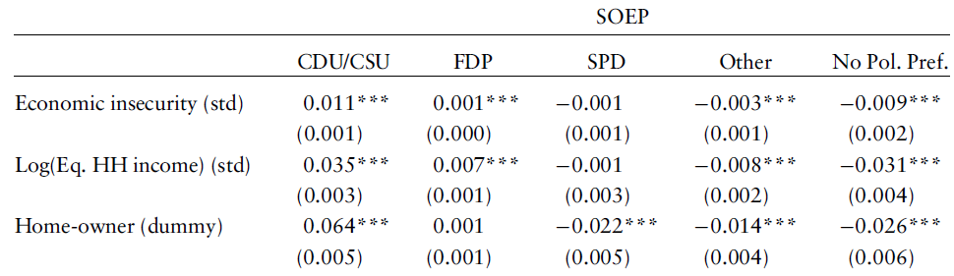
Economic insecurity mainly benefits Right-wing parties: SOEP multinomial logit

Slide 25
Heterogeneity
The effect of insecurity on RW preferences is larger for those who are married and those who are parents.
It is also somewhat more pronounced post-2000 than pre-2000.
No difference by income, or for homeowners vs. renters

Slide 26
USA UAS data. 2016 Presidential Election
UAS is a panel of households of approximately 6,500 respondents representative of the entire United States. The study is an Internet panel, and respondents answer surveys online at their time of choosing.
From May 31st 2014 to August 2018, the University of Southern California conducted approximately 150 different UAS surveys on different topics such as consumer behaviour, financial literacy or health. All of these include income information. Individuals could reply to as many of these as they wanted.

Slide 27
There were 4,295 respondents in the UAS Election Poll Study wave (July 4th to November 7th 2016) who reported their probability (on a 0-100 scale) of voting in the election, and of voting for Trump, Clinton or any of the other candidates.
2,358 respondents are between 18 and 60 years old, not retired and have at least five records of household income before the start of the election poll survey.
On average, these 2,358 individuals had 28 income observations between the first study and the election poll study.

Slide 28
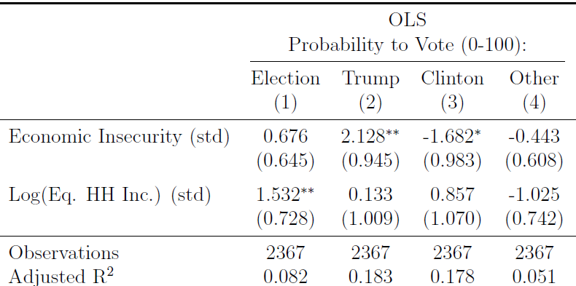

Slide 29
UK Understanding Society. Brexit
Wave 8 UKHLS Respondents were asked “Should the United Kingdom remain a member of the European Union or leave the European Union?”
The question was asked in 2017 and 2018, over a year after the actual referendum (June 23rd 2016).
41% replied “Leave the EU”.

Slide 30
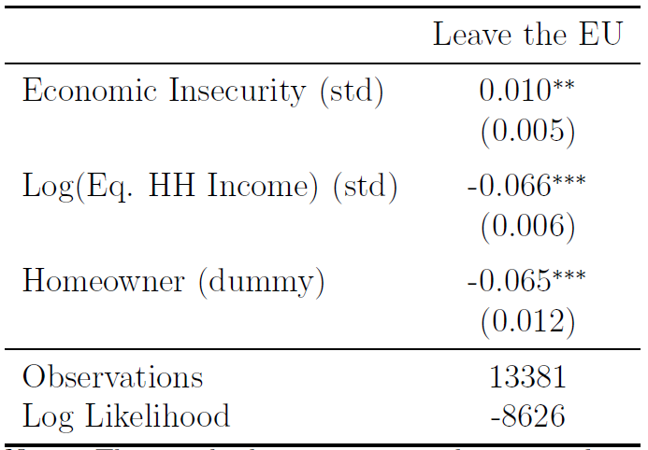
Insecurity favours Brexit

Slide 31
Value-Added Model
Our main results above related political preferences at t to economic insecurity at t-1.
Is there an omitted variable predicting both past economic insecurity and current political preferences?
We estimate a value-added model controlling for political preferences at t-2.
The intuition is that any omitted variable Z that predicts both economic insecurity at t-1 and political preferences at t will also be picked up by political preferences at t-2.

Slide 32
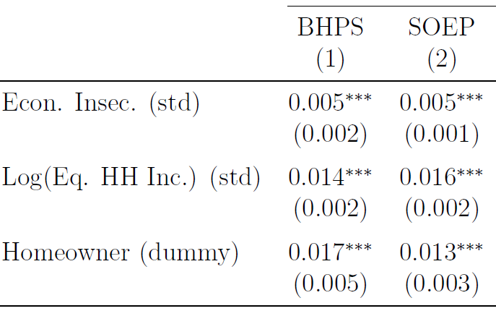
Compared to baseline, the marginal effects of economic insecurity (as well as those of household income and homeownership) fall by about a half, but are all still significantly different from zero.

Slide 33
A Beauty Contest of Indices
Our index is not the only measure of economic insecurity based on income changes.
Hacker et al.: insecurity = 25%+ drop in available income over the past year
the variance in household equalized income over five years.
Change in income from t-2 to t-1
Trend growth in income from t-5 to t-1
The best model is the one with our index since it has the least-negative log-likelihood.

Slide 34
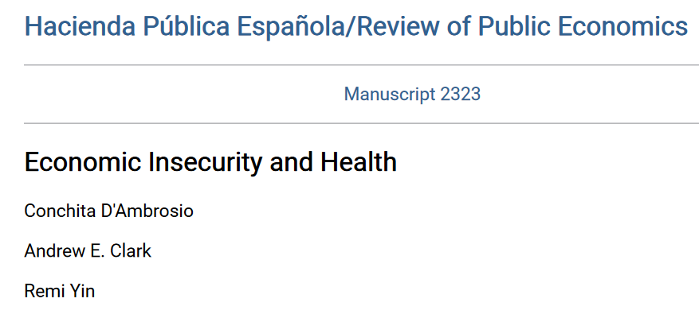
Economic Insecurity and Health
We show that individual-level economic insecurity, based on the time profile of economic resources, is detrimental to both physical and mental health in long-run Australian panel data.
HILDA 2001-2018
The empirical analysis will cover all non-retired individuals aged between 20 and 65 for whom all of our dependent and control variables are measured. The analysis sample consists of around 144 000 observations on a little over 20 000 individuals

Slide 35
The physical- and mental-health measures come from the health components of the Medical Outcomes Study Short-Form survey (SF-36) that appears in every HILDA wave.
The SF-36 is a health questionnaire with 36 questions that can be used to analyse the health of a general or specific population.
From these 36 questions are obtained two summary measures:
the physical component summary, or PCS
the mental component summary, or MCS

Slide 36
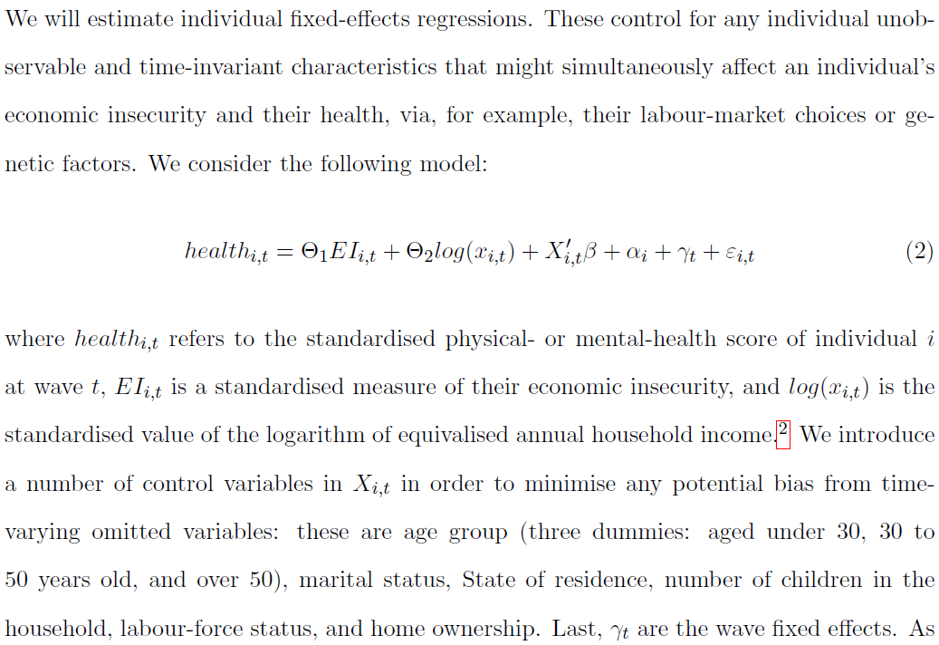


Slide 37
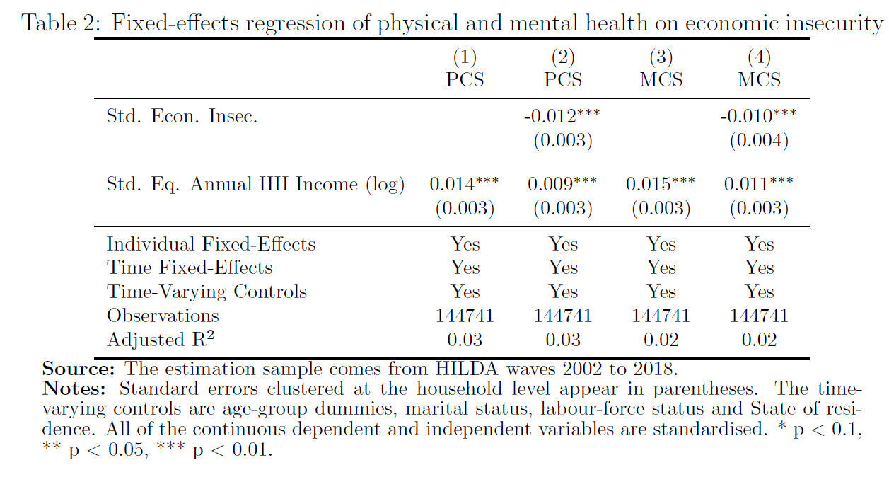

Slide 38
The above findings are not causal.
We would really like an exogenous change in EI that affected one group but not another.

Slide 39
We should here be grateful for the natural experiment of
Layoff tax Reforms
These reforms of layoff taxes protected one group, but made the other group more insecure as a result.
1999 rise in the Delalande Tax in France – effects on fertility (Clark, Lepinteur, 2022) and marriage (Clark, D’Ambrosio and Lepinteur, 2022)
2012 Fornero Reform in Italy – effects on savings and consumption (Clark, D’Ambrosio and Lepinteur, 2023)

Slide 40
The Delalande Tax
1987: New Employment Protection Legislation tax in France – the Delalande Tax
Main features:
  Firms laying off workers over a certain age have to pay the tax to the unemployment-insurance system
  Tax is proportional to the worker's gross wage
  Covers private-sector workers with permanent contracts
Tax Scheme changed over time and across firm sizes

Slide 41
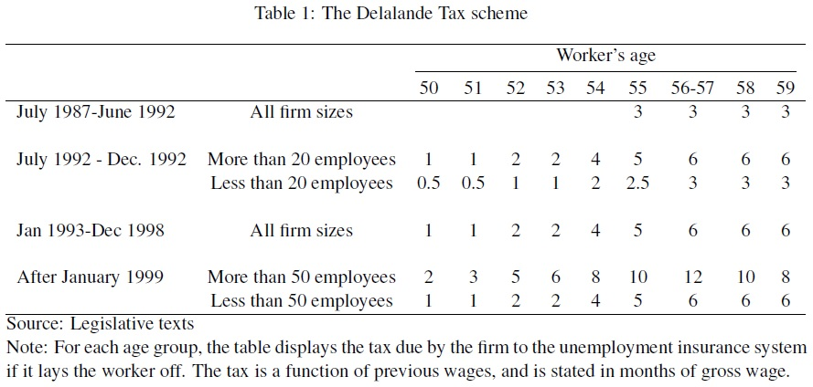
The Delalande Tax Scheme

Slide 42
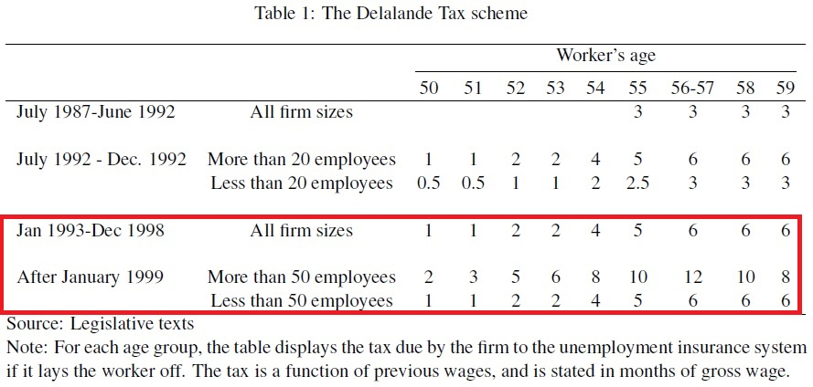
The 1999 rise in the Delalande Tax

Slide 43
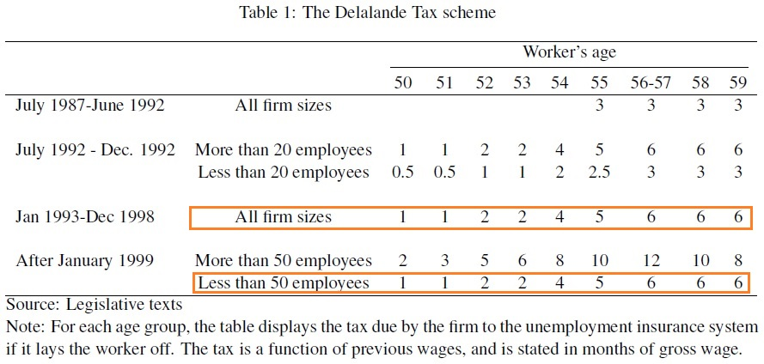
The 1999 rise in the Delalande Tax

Slide 44
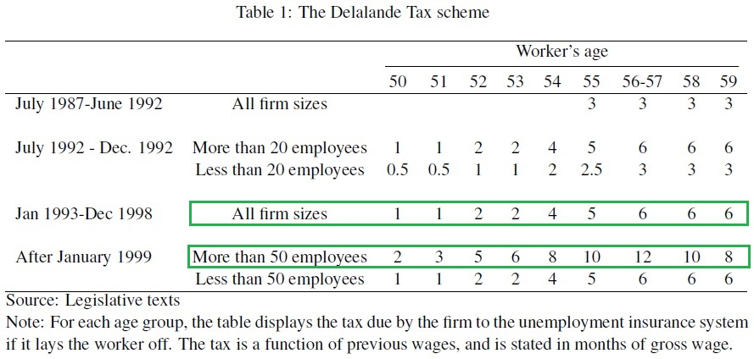
The 1999 rise in the Delalande Tax

Slide 45
A higher firing tax on workers 50+ in large firms (lower separation rate)
No change in firing tax on workers 50+ in small firms
Workers aged < 50 in large firms experienced higher insecurity wrt workers aged < 50 in smaller firms after January 1999.
This rise in job insecurity is seen in both subjective job security and actual turnover rates.

Slide 46
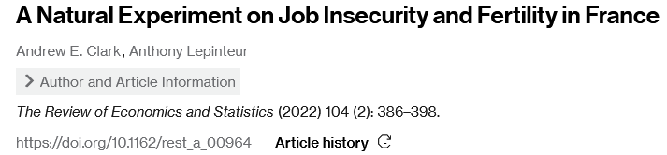
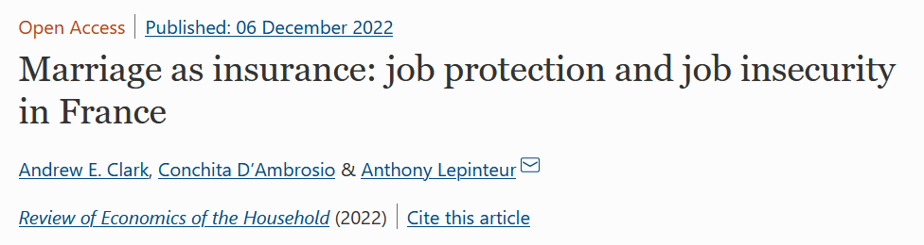
Job Insecurity, Fertility and Marriage: Difference-in-differences

Slide 47
Job Insecurity, Fertility and Marriage: Difference-in-differences
Y_{it}: Perceived job security, probability to be have a new child and to be married
Focus on workers below age 50 (changes in marital status are less frequent at later ages)
Treated (Treat_{it} ): Large firms (50+ employees); control firms (< 50 employees)
1998: Announcement of the reform
From January 1999 onwards: Post reform
λ₁₉₉₈: 1998-wave FE
Post₁₉₉₈ and Post₁₉₉₇: dummies for after 1998 and 1997 respectively

Slide 48
Data - European Community Household Panel (ECHP)
  14 European countries, 1994-2001
  Information on socioeconomic characteristics, employment conditions…
  …and marital status and perception of job security (our main dependent variables)
  “How satisfied are you with your present situation in the following areas? (Please use a scale of 1 to 6, position '1' meaning you are not satisfied at all and '6' meaning that you are fully satisfied.)”
  Your Job Security

Slide 49
Sample for Fertility: Married French private-sector workers aged 20-49 with permanent contracts (4698; 1040)

Slide 50
Panel regressions: treated workers report greater job insecurity

Slide 51
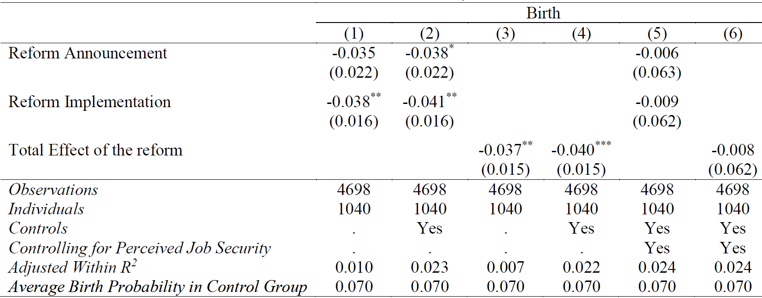
And reduced their fertility
Lower fertility entirely driven by perceived job insecurity

Slide 52
Parallel-trend assumption (raw data)

Slide 53
Robustness checks
Results unchanged if:
  We exclude workers in firms with more than 20 employees ➔ no confounding effect of the 35-hour workweek of 2000
  We use pooled OLS and non-linear estimation methods ➔ the estimation method does not drive the results
  We exclude workers in firms between 20 to 100 employees (donut DiD) ➔ Firm size misreporting is unlikely to affect our estimates
There are no significant estimates for Spanish, Italian and Danish workers (placebo) ➔ common macroeconomic shocks do not drive the results
Heterogeneity
Effect on fertility is stronger for high-wage and educated workers (negative selection into fertility) and parents (effect is at the intensive margin)

Slide 54
Sample for Marriage: All French private-sector workers aged 20-49 with permanent contracts (10371; 2797)

Slide 55
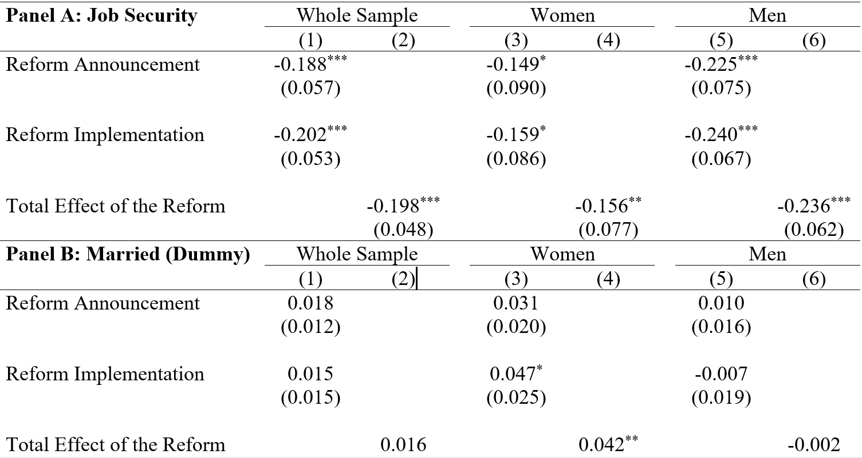
The treated workers again feel more insecure
Only women get married following lower job security

Slide 56
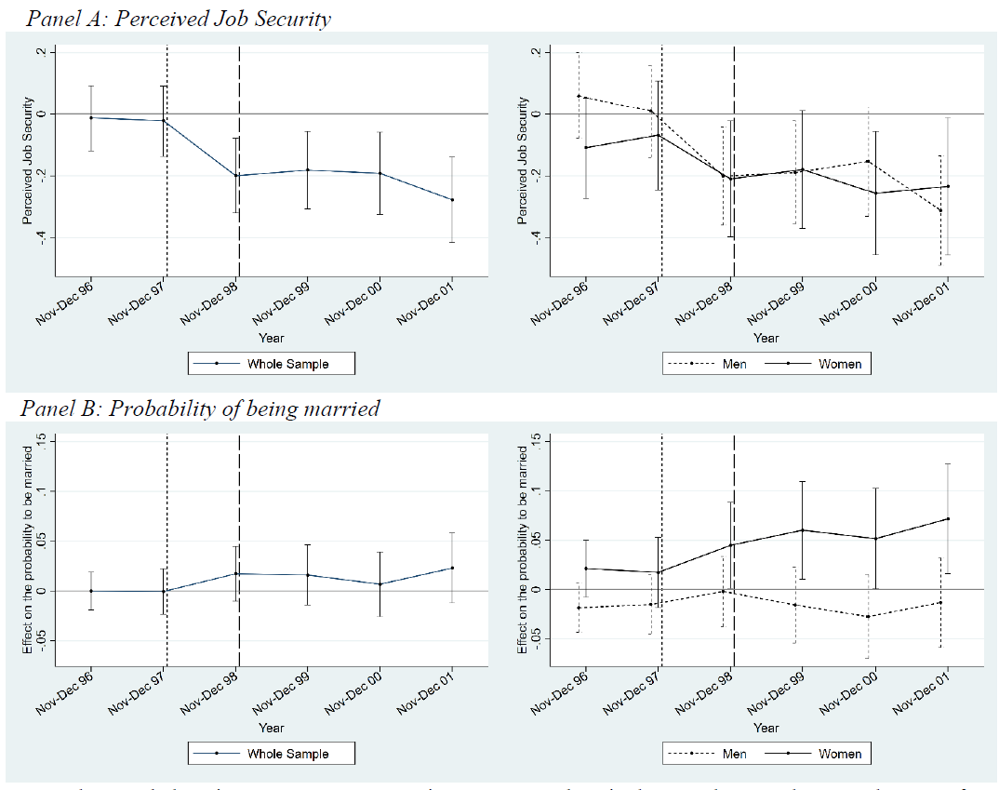
Parallel-trend assumption (panel results)

Slide 57
From Cohabitation to Marriage only

Slide 58
A last thought on insecurity and risk-sharing
We find a larger effect for those facing the most loss: mothers
If our estimates really reveal behaviours in line with risk-sharing theory, treated women should not marry men with greater job insecurity
This is what we find. Treated women are less likely to get married to:
  Unemployed men
  Men who are themselves affected by the higher Delalande tax

Slide 59
What about savings?
One of reasons why we save is because the stream of future income is unknown ➔ the greater the risk, the greater is the need for precautionary savings
Empirically, there is no consensus in the literature about the importance (or even the existence) of precautionary savings
  Several issues in the literature:
    No harmonised definition of risk and precautionary savings
    Mostly correlations

Slide 60
The Italian Labour Market: rules for unlawful dismissal
From 1970 to 2012 ➔ Dismissal of permanent private-sector workers for:
Just cause (e.g. violence, harassment)
Justified reason
  Subjective (e.g. breach of contract)
  Objective (e.g. economic reasons)

Slide 61
The Italian Labour Market: rules for unlawful dismissal
From 1970 to 2012 ➔ Consequences of unlawful dismissal depend on firm size:
For firms with 15 employees at most: employer chooses between:
  Reinstatement (without forgone wages)
  Compensation (ranging from 2.5 to 14 months)
For firms with more than 15 employees: employee chooses between:
  Reinstatement + all forgone wages since layoff day
  Compensation (ranging from 5 to 15 months)

Slide 62
The Italian Labour Market: rules for unlawful dismissal
July 18, 2012: Implementation of the Fornero Reform
For firms with up to 15 employees: No Change
For firms with over 15 employees:
  Less power to employees:
    Judge decides between reinstatement and compensation
    Reinstatement limited to a subset of unlawful dismissals
  Less costly for employers:
    All types of compensations are capped (12 to 24 months)
    Clearer legal definition for unlawful dismissal (less time in court, trial verdict less uncertain)

Slide 63
Data – Survey of Household Income and Wealth (SHIW)
This reform then produced a rise in job insecurity in larger firms, as compared to smaller firms, that is seen in both actual turnover and separation rates (Berton et al., 2017).
  Italy, started in the 1960s, bi-annual since 1998
  Repeated cross-section
  Information on socioeconomic characteristics, employment conditions…
  …and detailed information about income, consumption and savings

Slide 64
Job Insecurity, Savings and Consumption: Difference-in-differences
Y_{it}: Monthly savings and consumption (equivalised – sqrt family size)
Focus on workers hired before 2012 (no endogenous change in sample composition due to change in hiring decisions)
Treated (Treat_{it} ): Large firms (more than 15 employees); control firms (15 employees or less)
2012: Reform was introduced in July 2012
λ₂₀₁₂ and λ₂₀₁₄ : 2012-wave and 2014-wave FE

Slide 65
Sample for Savings: All Italian private-sector workers aged 20-49 with permanent contracts (12502; 8476)

Slide 66
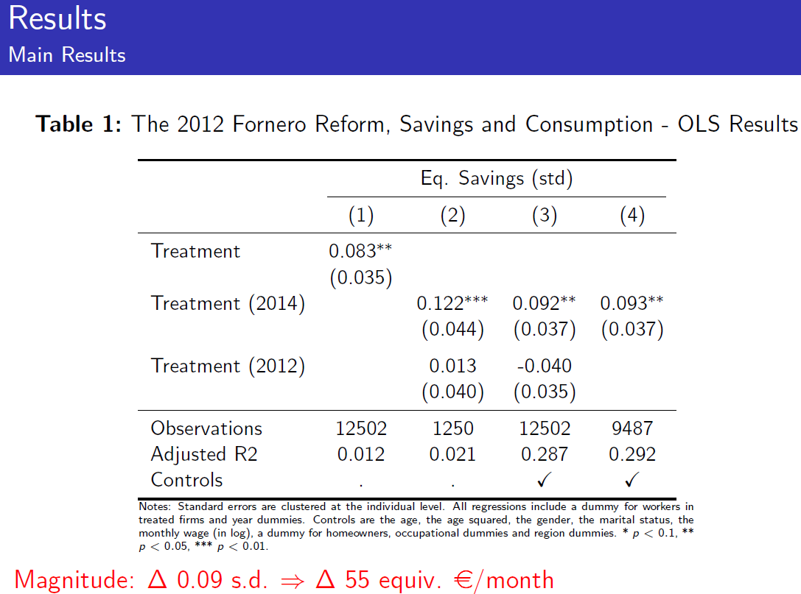

Slide 67
Parallel-trend assumption (pooled results)

Slide 68
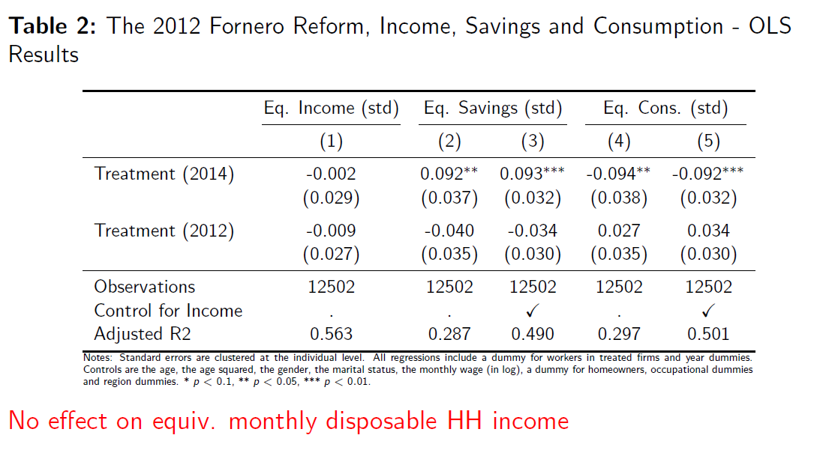

Slide 69
Robustness checks
Results are the same when:
  we change the definition of the dependent variables:
    OECD equivalence scale
    No equivalence scale
    IHS transformation
  we exclude potential outliers (top and bottom 1% trimmed)
  we account for measurement errors in self-reported firm-size (donut DiD)

Slide 70
Conclusion
Greater insecurity increases right-wing voting and Brexit support
Insecurity is also detrimental to both physical and mental health
Greater insecurity reduces fertility, increases the marriage probability of women and increases savings.
Insecurity provokes the need for precautionary savings

